Slide 1

Node.js:
The Harmony of Asynchronous, Event-Driven, and Single Threaded Architecture

Slide 2
Introduction to Node.js
Node.js is a powerful JavaScript runtime built on Chrome's V8 engine. It enables developers to create efficient and scalable network applications. This presentation explores its asynchronous, event-driven, and single-threaded architecture, providing insights into how these features contribute to Node.js's performance and usability

Slide 3
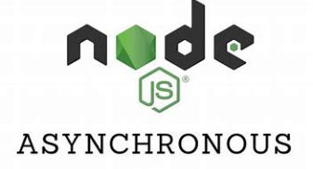
Asynchronous Programming
Asynchronous programming in Node.js allows for non-blocking operations, enabling multiple tasks to run concurrently. This is achieved through callbacks, promises, and async/await syntax. By leveraging this model, developers can enhance application performance and responsiveness, particularly in I/O operations.

Slide 4

Event-Driven Architecture
Node.js utilizes an event-driven architecture where events trigger actions. The EventEmitter class is fundamental, allowing objects to communicate through events. This design pattern simplifies the handling of concurrent requests, making Node.js particularly effective for real-time applications like chat services and online gaming.

Slide 5
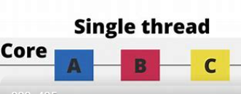
Single-Threaded Model
Node.js operates on a single-threaded model, utilizing the event loop to manage multiple connections. This approach reduces the overhead associated with thread management, allowing for efficient handling of numerous simultaneous requests without the complexity of multi-threading, which can lead to concurrency issues

Slide 6

Benefits of Node.js
The harmony of asynchronous, event-driven, and single-threaded architecture in Node.js offers several advantages. These include improved scalability, enhanced performance for I/O-bound tasks, and a unified language for both client and server-side development, making it a popular choice for modern web applications

Slide 7
Conclusion
In summary, Node.js's unique architecture fosters a high-performance environment for building scalable applications. Its asynchronous, event-driven, and single-threaded features position it as a leading choice for developers aiming to create efficient, real-time web applications in today's digital landscape

Slide 8
Thank You
By – Alpana Kumari
(22105054)

